Slide 1
Weather vs Gas Prices
Ashley Armijo, Trey Bailey, Jake Cook, Stephen Min

Slide 2
INTRODUCTION
Does weather have an impact on gas prices across the United States.
H: Weather does have an impact on Gas Prices
NH: There is no correlation between Weather and Gas Prices

Slide 3
Questions
What month was the hottest?
What month had the highest gas prices?
What city is the hottest)?
What city has the highest gas prices (yearly and monthly)?
5. How does each city compare to US average (weather and gas)?
6. Does the weather affect gas prices?

Slide 4
Process
Step 1
Step 3
Step 2
Step 4
Step 5
Find working data, team pivoted on the question and data sets multiple times
Create calculations
Clean data in jupyter notebook so that two data sets could be compared
Create graphs and conduct analysis
Create presentation

Slide 5
Data Sources
Gasoline Prices
Weather Data
U.S. Enegry Information Administration
https://www.eia.gov/dnav/pet/pet_pri_gnd_a_epmr_pte_dpgal_w.htm
World Weather Online
https://www.worldweatheronline.com/developer/

Slide 6
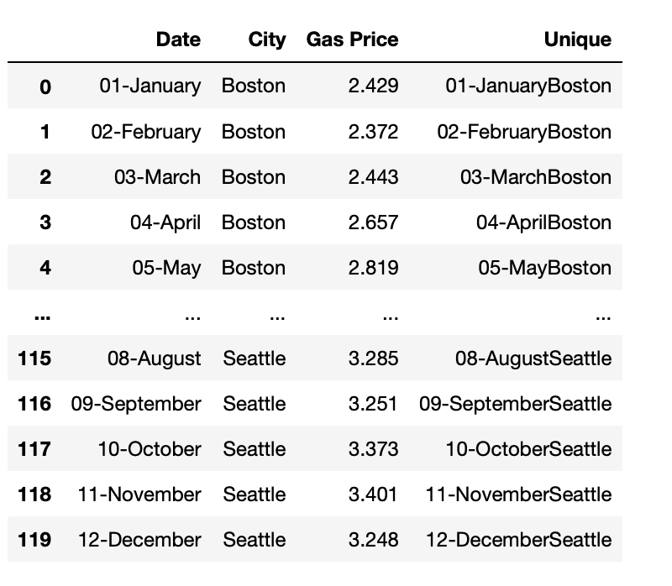
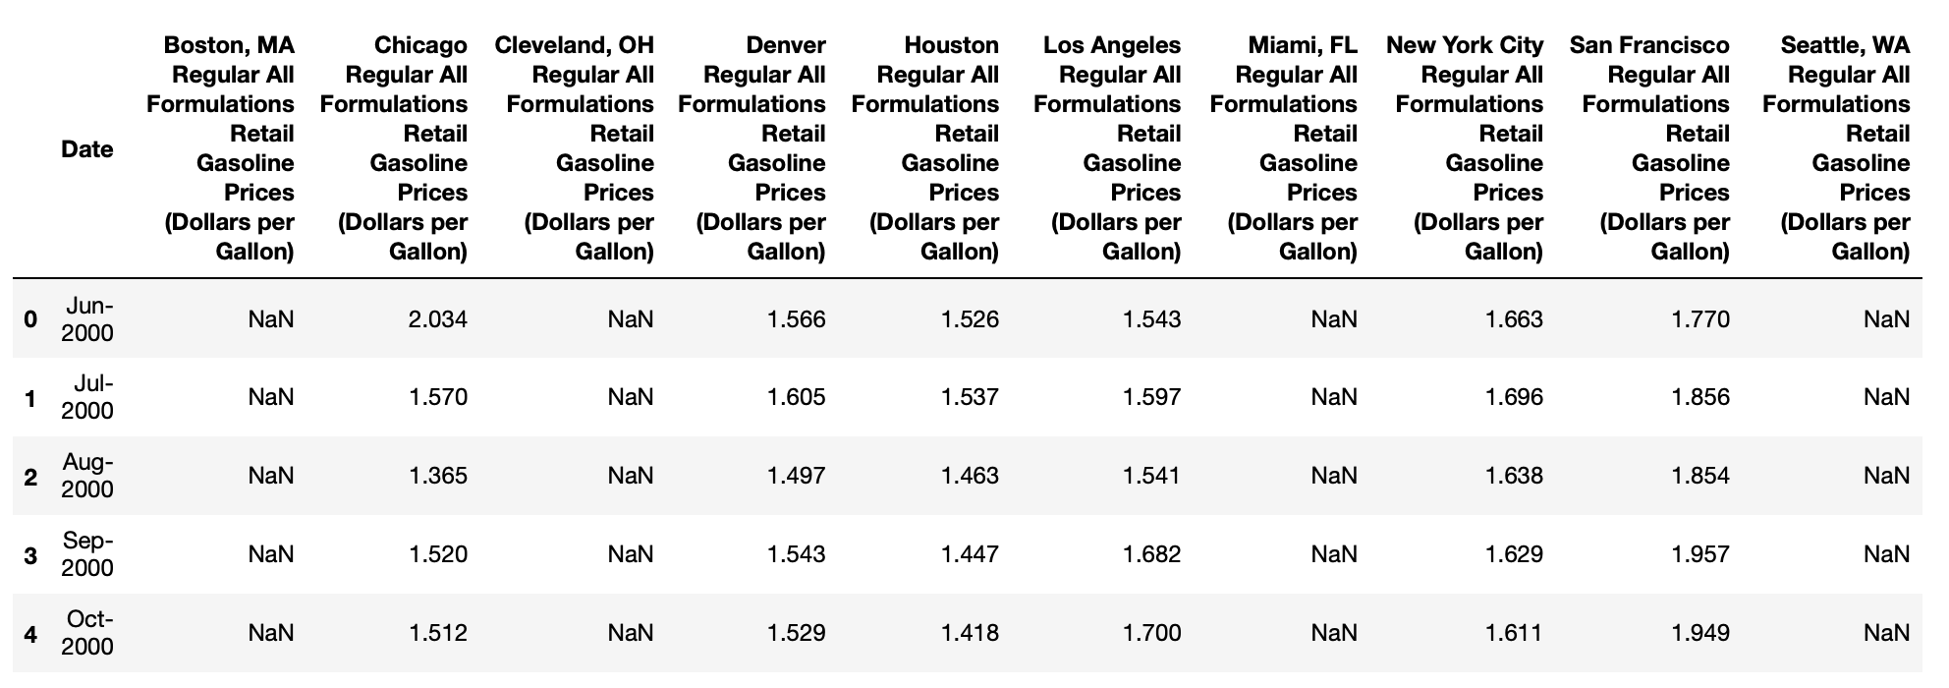
Data Clean Up – Gas Prices
Import CSV into Jupyter
Rename columns to just the cities
Transpose City columns to one City Column
Filter for only 2019 Dates
Rename 2019 Dates
Add a unique column to merge on

Slide 7
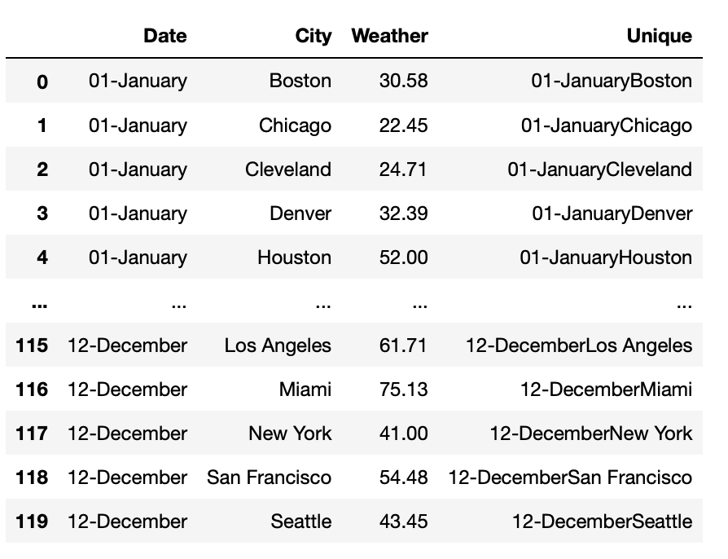
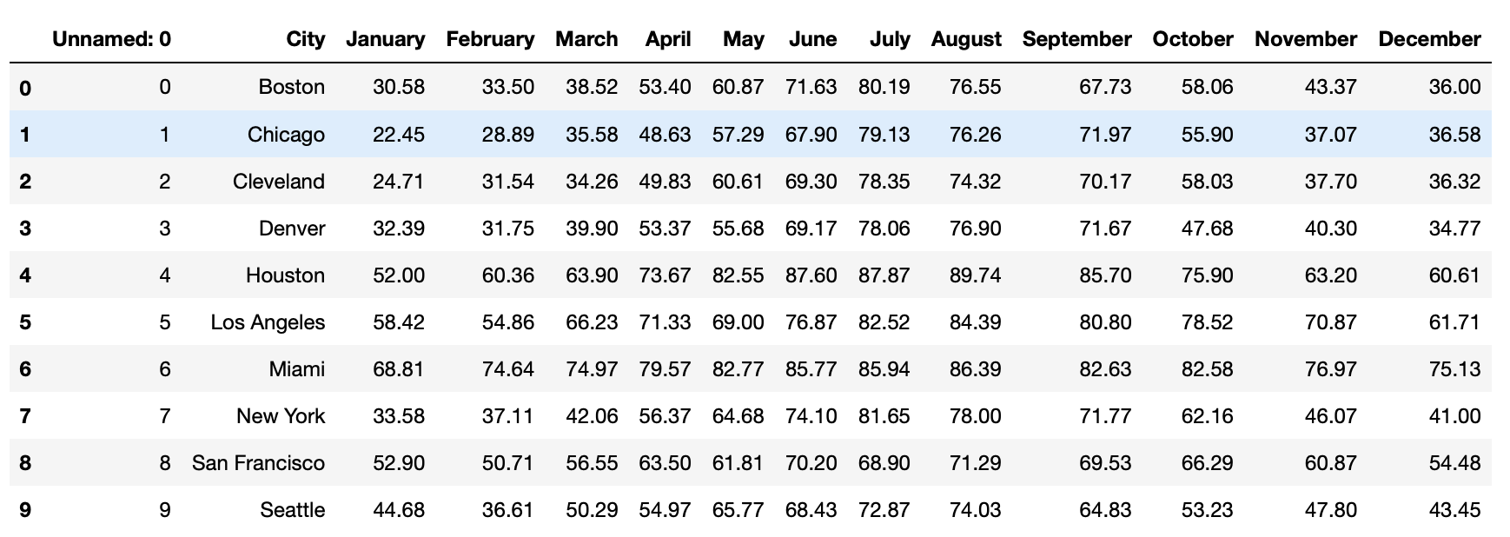
Data Clean Up – Weather
Import CSV into Jupyter
Drop Unecessary columns
Transpose Date columns to one Date Column
Rename 2019 Dates
Add a unique column to merge on

Slide 8
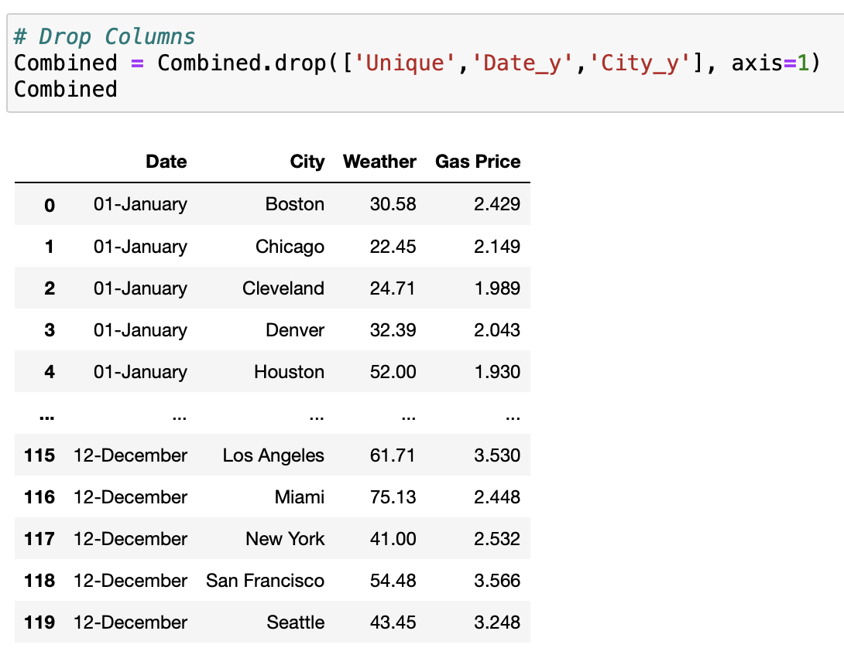
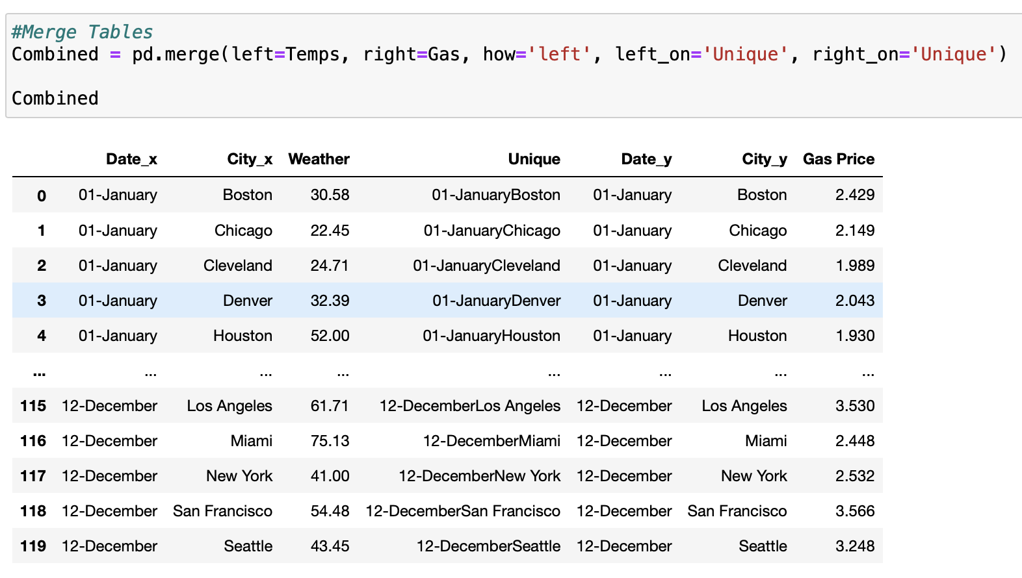
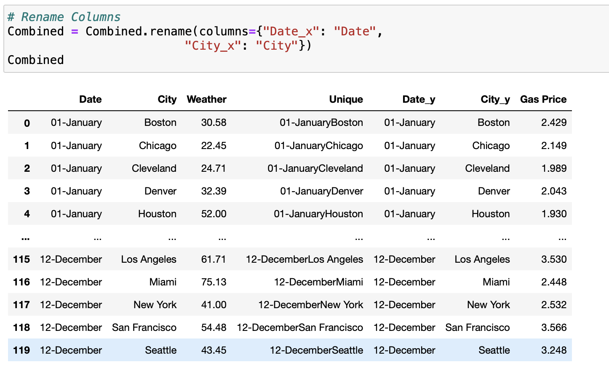
Merge Data
Left Merge on Column - Unique
Rename Columns
Drop Columns

Slide 9
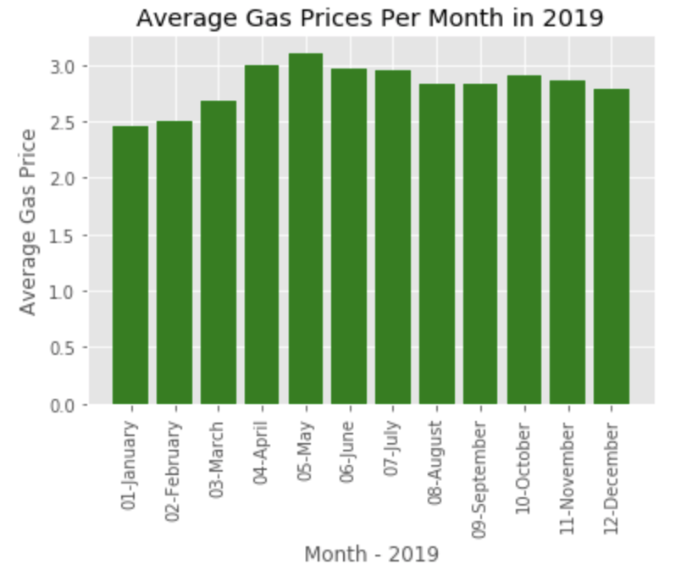
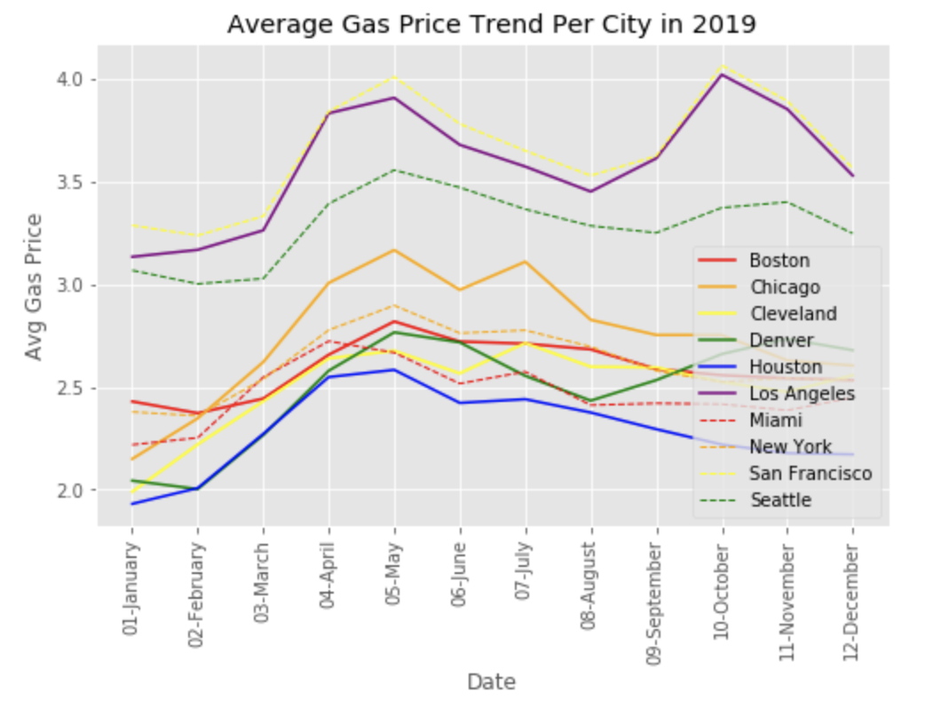
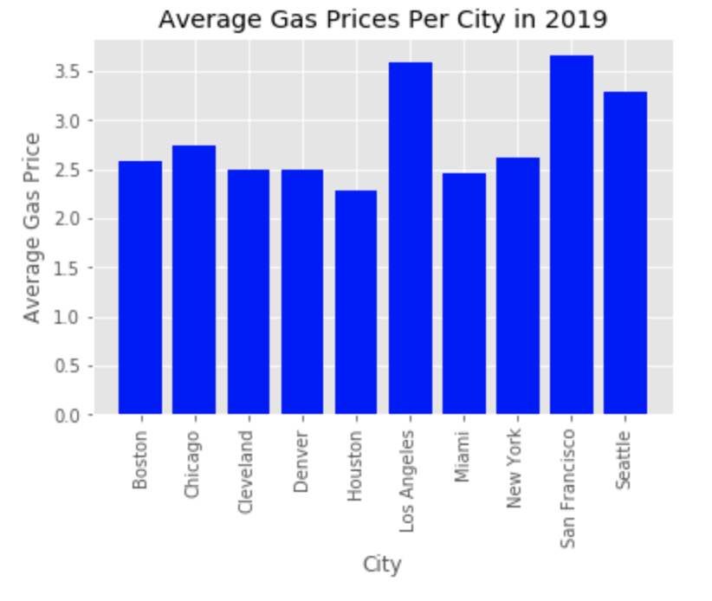
Gas Data
$3.11 - May
$3.65 – San Francisco

Slide 10
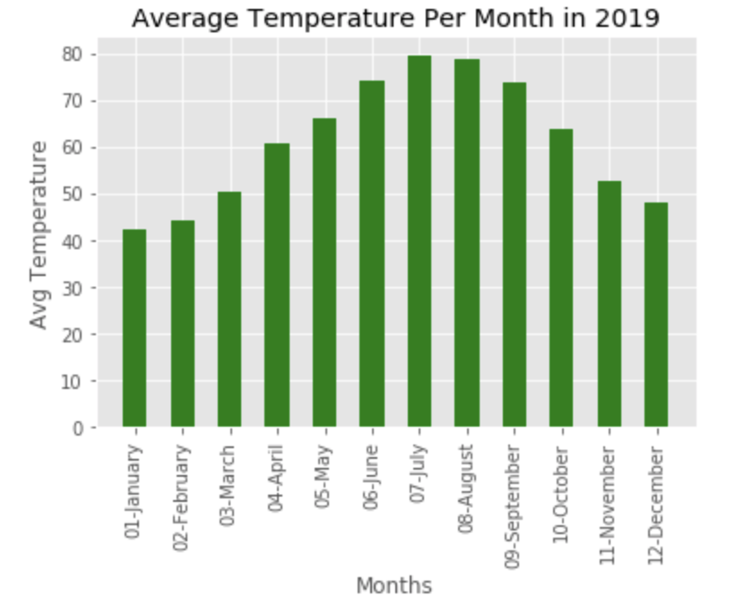
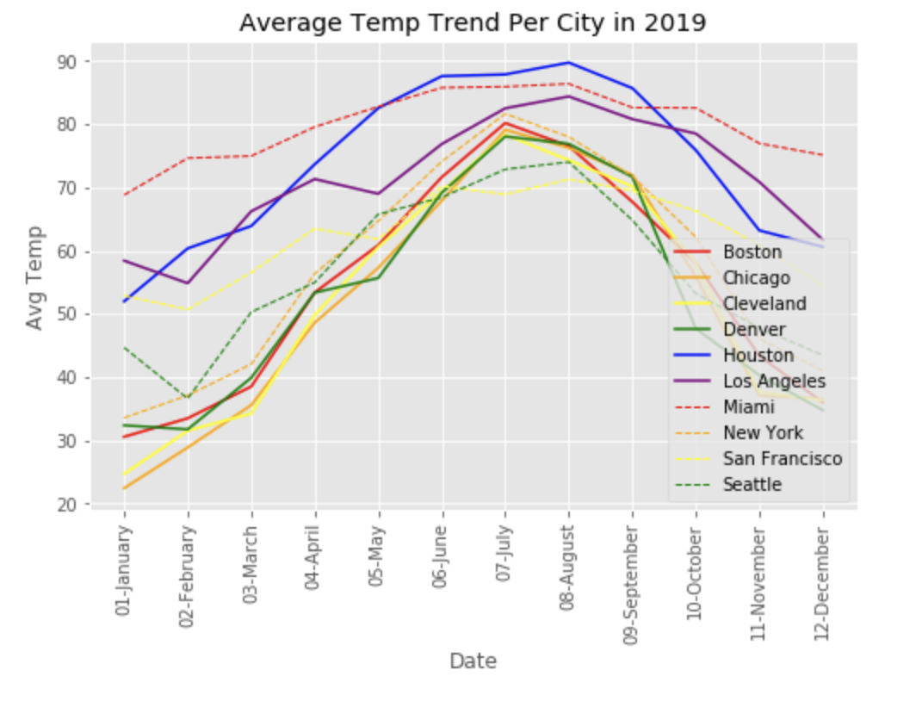
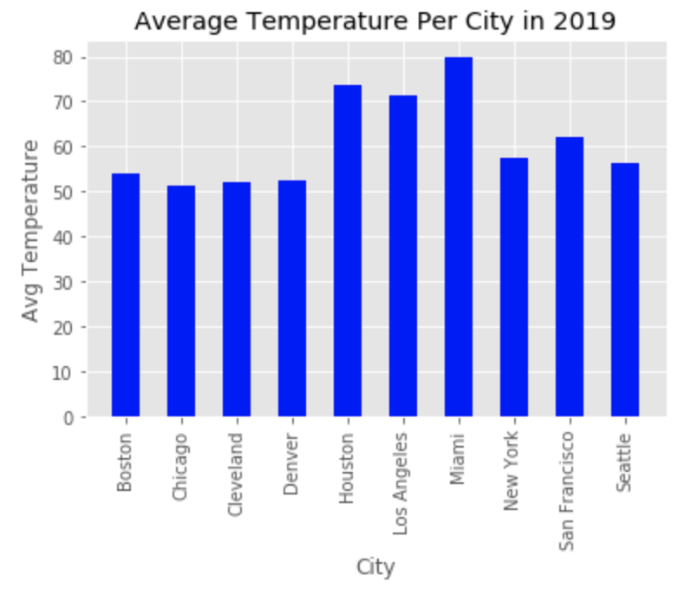
79.54 - May
Weather Data
79.68 – Miami

Slide 11
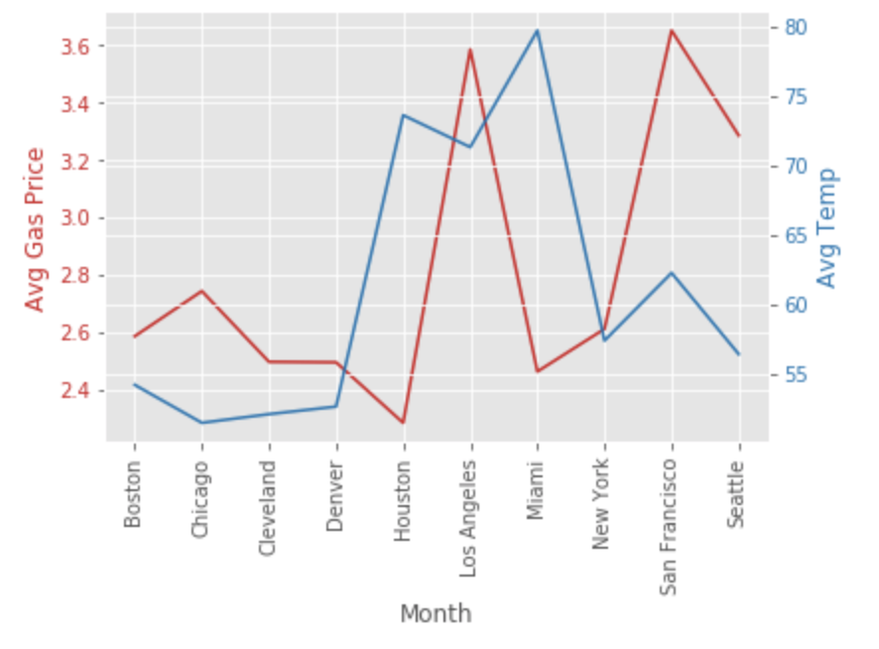
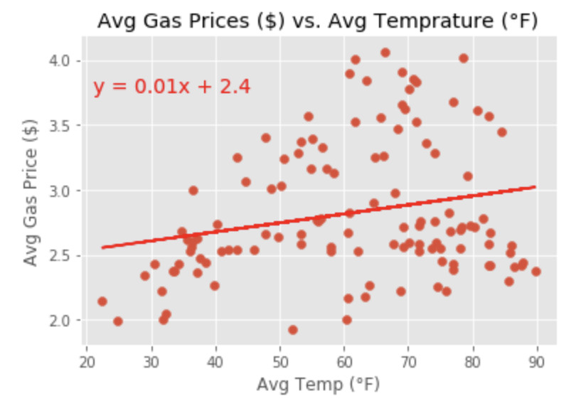
Gas/Weather Data
The correlation coefficient between temperature and gas prices is 0.23 and shows that there is a weak correlation

Slide 12
Summary
There is no correlation between temperature and gas price.
Final Project Folder: https://github.com/stephenkmin/Project-1/tree/master/Final%20Project

